Slide 1
Social Observatory
Graphql data server intro

Slide 2
Topics: GraphQL
Introducing GraphQL
Data Model
Demonstration 1: native interface
Demonstration 2: hacked interface

Slide 3
TRADITIONAL WAY OF API DATA ACCESS
As a developer of applications, you typically need to build queries to restful endpoints to get data.
Manually creating http requests can be cumbersome,
On the backend of your application, you may need to make queries to multiple sources (e.g. RDBMS and MongoDB)
Endpoints can, and often, return data in a heterogeneously structured manner
E.g. returning JSON of a user model vs JSON of a group model

Slide 4
GraphQL
Represent the data you’re requesting with a server defined scheme for its data sources and client defined scheme for responses,
Have the server you’re requesting validate/verify your queries and perform the additional necessary queries (chained API calls)
View application data sources as a graph. The query is the root node, one may chain queries together to yield different structured objects

Slide 5
Example Client Query and Response
{
user(q:”Donald Trump”, count:1){
screen_name friends(count:100){
screen_name
}
}
}
{
“data”: {
“user”:[
{
“screen_name”:”realDonaldTrump”,
“friends”:[
“user”:{
“screen_name”:”BarackObama”
},
“user”:{
“screen_name”:”PutinRF_Eng”
},
...
]
}]
}
}
You’ll get exactly what you expected!

Slide 6
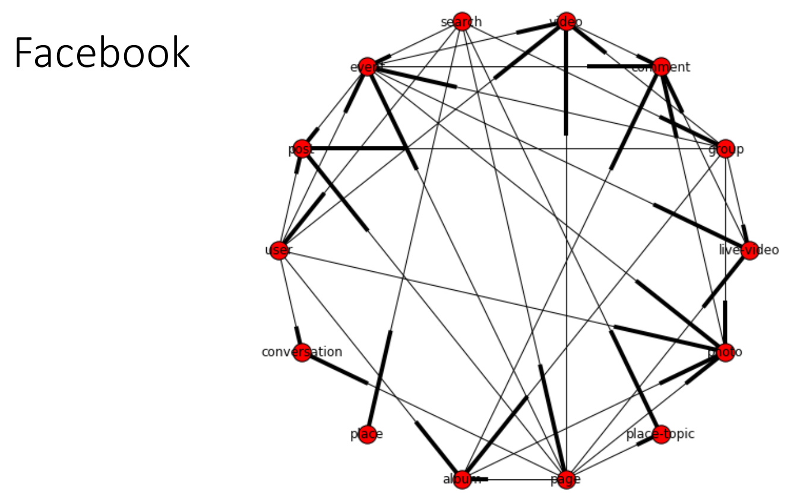
ROOT
Each node is a data object. More intuitive to represent data
Chained API calls are made easy in Graphql, which allows more information

